Slide 2
What is Free Speech?
It’s the oral or written exchange of ideas, particularly those with some type of political, scientific, literary or artistic value
It’s when you work to educate others and to request action from decision makers
It’s speech and “expressive conduct,” such as wearing armbands, emojis, kneeling, etc.
It also includes the right not to speak (e.g. declining to say the Pledge of Allegiance)
It’s some types of conduct

Slide 3
Unprotected Speech Under the First Amendment
Fighting Words and True Threats
Speech That Incites Lawless Action
Criminal Acts
Harassment
Defamation
Obscenity and Child Pornography
Commercial Speech
Time, Place and Manner Restrictions
Source: “A Pocket Guide to Free Speech and Peaceful Assembly” brochure, PaperClip Communications, 2017

Slide 4
What About Hate Speech?
Generally, speech associated with inflammatory messages (e.g. displaying swastikas or burning crosses) is still protected under the First Amendment.
But, under certain circumstances, like if the speech fits into a non-protected category such as “true threats” or “incitement to violence,” such messages might still be considered unprotected speech.

Slide 5
Understanding the First Amendment
Ratified in 1791
Provides for Freedom of…
Religion
Speech
Press
Assembly
Petition

Slide 6
What is Peaceful Assembly?
YES
Encouraged for people to discuss important matters, express dissent and exchange ideas
NO
Disruptive gatherings that encourage others to act violently or destructively, endanger or threaten others’ safety, or otherwise break the law are NOT protected by the First Amendment
DISSENT
DISCUSSION
DISRUPTION
DESTRUCTION

Slide 7
Exercising Your Right to Free Speech Effectively & Respectfully
There are some key ways to work on your message and get it across effectively
Important to engage in civil discourse and listen to differing viewpoints
Explore all sides of an issue so you can advocate effectively
Learn to articulate your opinions respectfully
And know when to disengage and how to de-escalate a situation

Slide 8
Identifying Your Message
Before tossing your message out in public, work to…
Make sure you’re clear about what you’re trying to say
Determine why the topic is important to you
Practice your talking points
Figure what you’d like others to do

Slide 9
Using Speech Effectively
Determine what you’re trying to achieve
Make sure your message is clear
Think about how to get the word out
Consider your audience
Strategize with those who share your goals
Be sure to listen!
Am I trying to raise awareness? Have others take action?
Is my message straightforward and understandable?
How can I spread my message?
Am I addressing a specific group? Administrators? Students?
How can I connect with others to get the word out together?
Am I really listening to others?

Slide 10
Being a Good Listener
“Free speech carries with it some freedom to listen.”
– Warren E. Burger, former Chief Justice of the U.S. Supreme Court
Listening is key when connecting with others and gathering varying viewpoints
Empathetic Listening – where you ask yourself…
What you hope to gain from a conversation
What assumptions you’ve got
How you can respect the humanity of those with whom you’re in dialogue

Slide 11
Being a Good Listener
(continued)
“Free speech carries with it some freedom to listen.”
– Warren E. Burger, former Chief Justice of the U.S. Supreme Court
Listening is key when connecting with others and gathering varying viewpoints
Active Listening – listening to and responding to another person in a fully engaged, reflective way that leads to better understanding. It involves…
Giving your full attention
Setting the stage
Being in the moment
Displaying non-verbal feedback
Limiting advice
Not passing judgment
Being patient
Asking questions and repeating back

Slide 12
Engaging in Civil Dialogue
Be Respectful
Steer Clear of Condescension
Listen More Than You Speak
Use Inclusive Language
Admit When You’re Wrong
Don’t Match Aggression with Aggression
Agree to Disagree
Acknowledge Others’ Concerns
Be Open to Other Ways of Thinking
Engage

Slide 13
Exploring All Sides of an Issue
As we learn to listen well to others, we’re going to hear perspectives, insights and possible solutions
We need to listen to those who don’t think like us or agree with us
To be most effective, we need to look at all sides of an issue
This helps make sure our own positions on an issue are fully informed

Slide 14
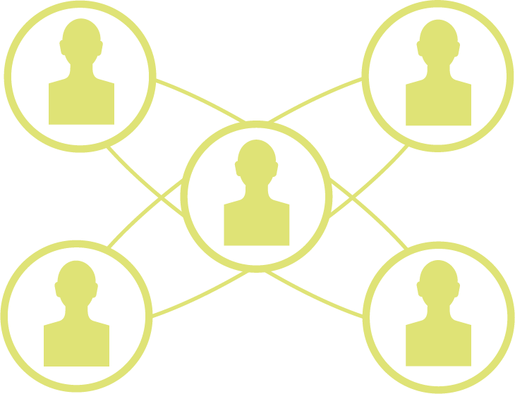
Being an Effective Advocate
Know What You’re Advocating For
Use Technology to Your Advantage
Immerse Yourself in an Issue
Focus Your Message
Show Others That You Care
Collaborate with Others

Slide 15
Engaging with Others
Discussion
Dialogue
Deliberation
Debate
Argument
Dictation/Diatribe

Slide 16
Articulating & Arguing Opinions
Some things to consider are…
The Susceptibility to Groupthink
Students’ Perceptions of “Arguments”
Thinking vs. Feeling

Slide 17
Agreeing to Disagree
“It’s possible to disagree without being disagreeable.”
– Former Supreme Court Justice Sandra Day O’Connor
Agreeing to disagree is about…
Listening to one another and not just pummeling others with our viewpoints
Learning to like and respect the people with whom you’re disagreeing
Recognizing that others may not agree with you – and vice versa
Seeing how disagreements can be good for us – offering opportunities to practice articulating our views while listening to others, too

Slide 18
Addressing the “Snowflake” Label
“A person, especially a young person, viewed as lacking resilience and being excessively prone to taking offence.” (Collins English Dictionary)
A label often used during free speech debates/discussions to negatively characterize college students who don’t like discomfort or having their views challenged, who expect colleges to be intellectual “safe spaces”

Slide 19
Using Disengagement Strategies
“Thank you for sharing. I’d love to talk further about this, but can’t do it at the moment. I’ve got to run.”
“That’s a lot you’ve said! I’d love to talk more about this when I am less worn out. Stop by again!”
“I will have to do my own research and think about this further.”
“I can see how many feel that way. I used to feel similarly, and then I thought…” (Feel-Felt-Thought method)

Slide 20
Interacting with Administrators
Getting active on campus is often about getting your message in front of campus decision makers who can impact change
Knowing how to do this effectively will ensure that your message is taken more seriously, so…
Do Your Homework
Distinguish Your Wants from Your Needs
Understand the Zero-Sum Game
Determine “Demands” vs. “Requests”

